Slide 1

ATM Banking System
Team – 4 Dept. of Computer Science & Engineering

Slide 2
Team - 4
Faisal Hossain Rabbany ( 16104040 )
Tashrif Al Hussain ( 16104042 )
Jim AL Sadik ( 16104058 )
Md. Ferdous Al Murad ( 16104076 )
Md. Tohidur Rahman ( 16104086 )
Rangan Mohanta Dibosh ( 16104090 )
Department of Computer Science & Engineering
Bangladesh Army University Of Engineering & Technology
Qadirabad Cantonment, Natore - 6431, Bangladesh

Slide 3
Contents
Introduction to ATM
PROJECT AIMS AND OBJECTIVES
BACKGROUND OF PROJECT
SOFTWARE REQUIREMENT SPECIFICATION
EXISTING VS PROPOSED
SYSTEM DESIGN
SYSTEM BUILD & IMPLEMENTATION
SYSTEM TESTING
CONCLUSION & FUTURE SCOPE
REFERENCES

Slide 4
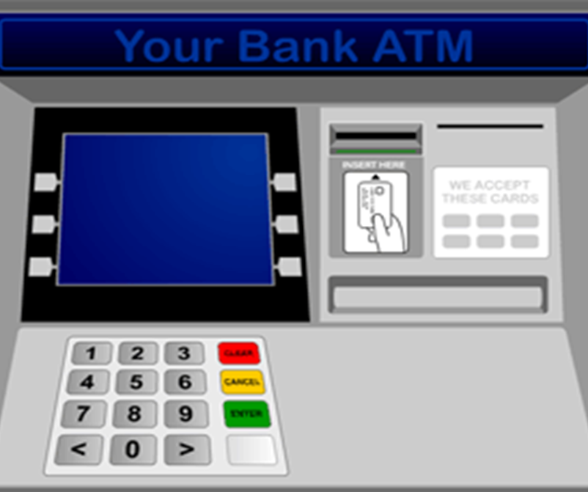
Introduction to atm
What is an ATM?
An ATM is an electronic device which allows a customer to make cash with drawl and check their account balance any time without the help of a human teller.

Slide 5
PROJECT AIMS AND OBJECTIVES
Highly secured encrypted database.
Improved data server sync System
Improved Online transaction
All advanced Features in ATM machine
Highly secured website for everything about banking detail
Advanced featured ATM in booth for everything in every crowed place, at any need or emergency that can be most usable for fastest banking & transaction all over the world.

Slide 6

BACKGROUND OF PROJECT
Fastest Transaction
Secured transaction
Safely deposit money
Remittance transaction
Online payment
Usable at everywhere
Payable at everywhere

Slide 7
SOFTWARE REQUIREMENT SPECIFICATION
For our development purpose we’ve some requirements that are very important to build our project properly. Those Software are:
JAVA Based Development Software
Database Software
We’ve used NetBeans as JAVA based Development kit & for database , we’ve used SQLite ( Specially an addon for Mozilla Firefox makes it easier for us to use ).

Slide 8
EXISTING VS PROPOSED
Existing Parts :
1. Digital Display
2. Online Banking
3. Withdrawal
4. Receipt
5. Transaction
Proposed Parts :
1. Deposit
2. Balance Check
3. Emergency Loan
4. Short Loan
5. Foreign Transaction
6. High Security

Slide 9
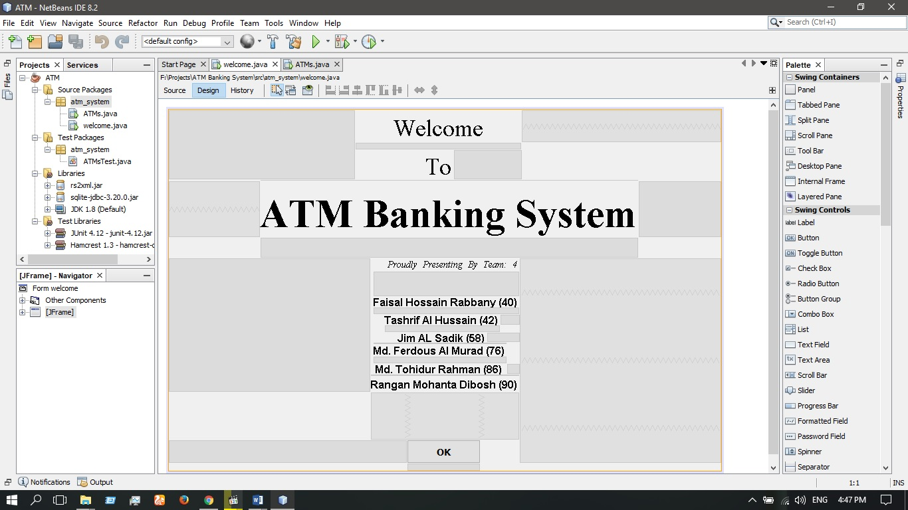
SYSTEM DESIGN
Welcome panel

Slide 10
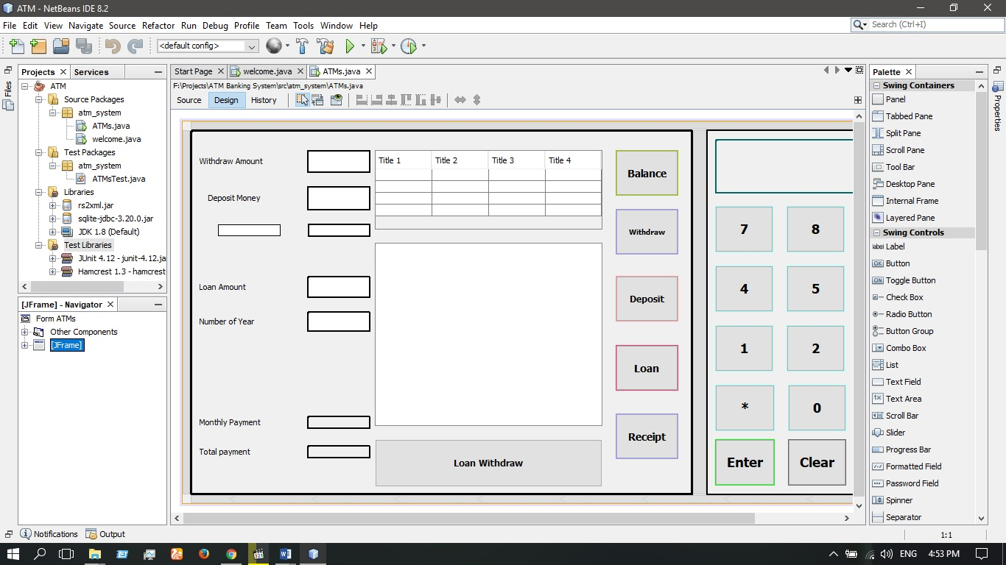
SYSTEM DESIGN
Working / banking panel

Slide 11
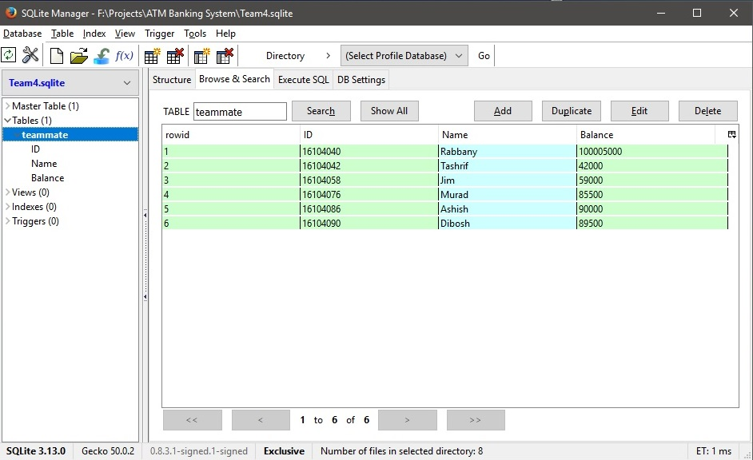
SYSTEM BUILD & IMPLEMENTATION
Database:

Slide 12
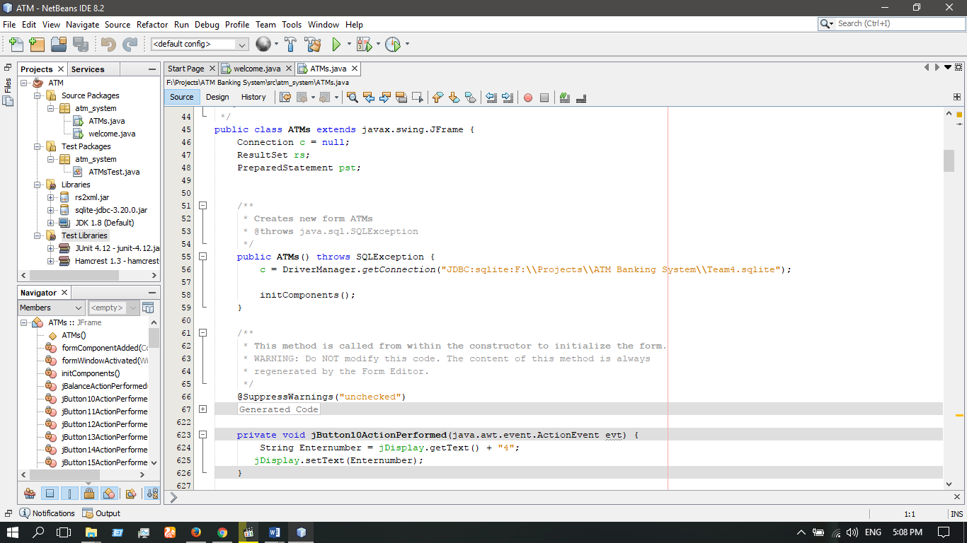
SYSTEM BUILD & IMPLEMENTATION
Database Connection With JAVA program:

Slide 13
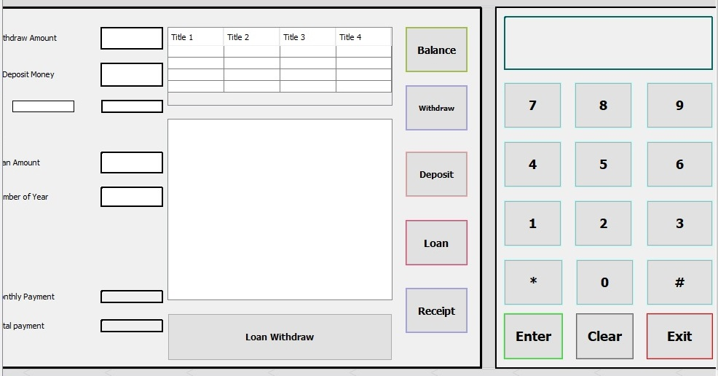
SYSTEM BUILD & IMPLEMENTATION
ATM Panel Designing:

Slide 14
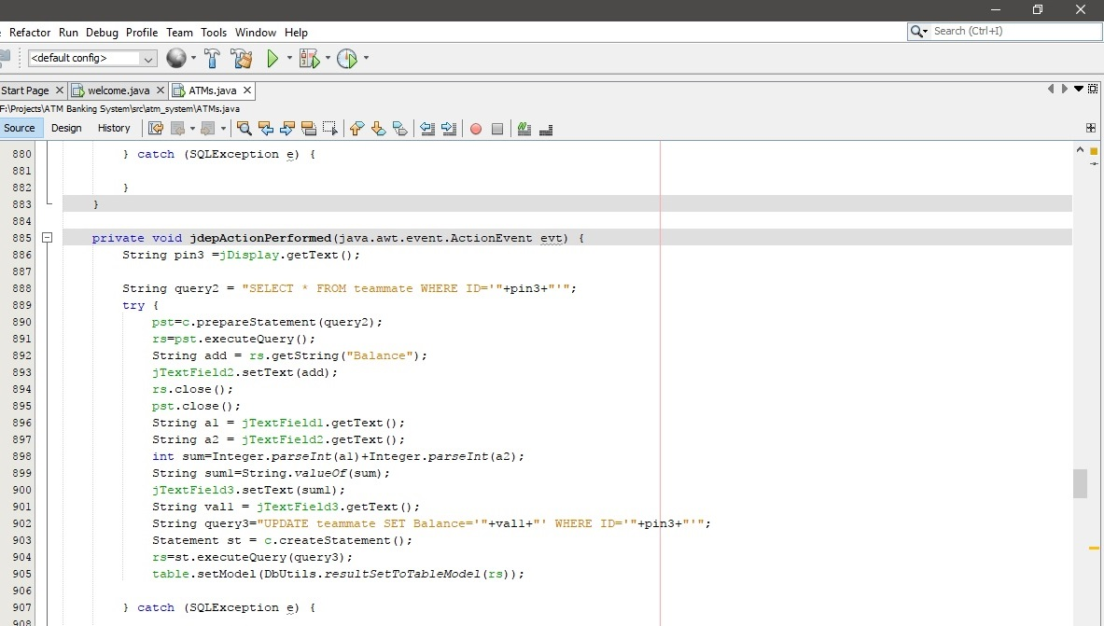
SYSTEM BUILD & IMPLEMENTATION
Query :

Slide 15
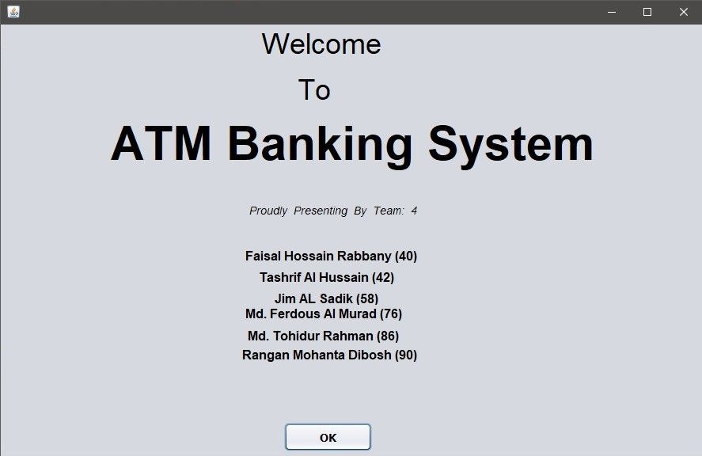
SYSTEM TESTING
Welcome Panel:

Slide 16
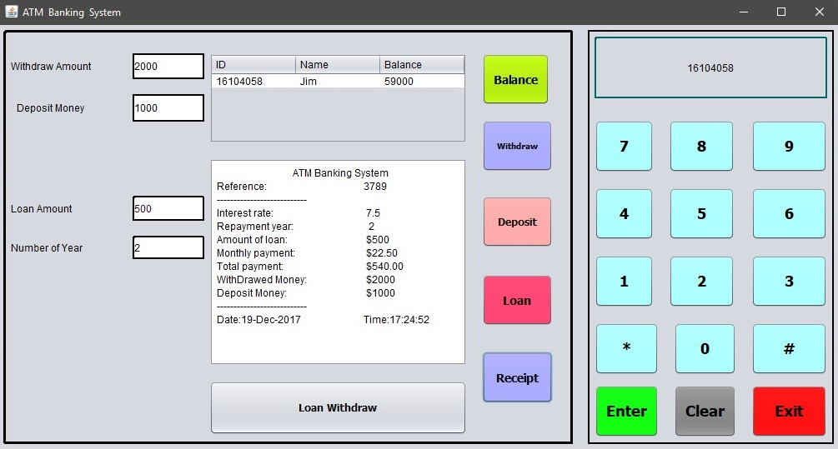
SYSTEM TESTING
Banking Panel:

Slide 17
CONCLUSION & FUTURE SCOPE
This ATM Banking System can not only just improve the security sides, but also the needy sides too. Our Country’s ATM Banking System now is like having a sharp brain, but with weaker limbs. Body doesn’t work properly like the mind tells it to do.
That’s why we are here. We’ve Developed our project based on the goals we proposed & we think we’re near about to done. We’ll continue it in future to make it better.

Slide 18
REFERENCES
Wikipedia.org [Data & Resource]
Google.com [Search Engine]
Youtube.com [Tutorials & Resources]
Udemy.com [Tutorials]
Linda.com [Tutorials & Resources]
City Bank Ltd., NSU Branch [ATM Demo]
AB Bank Ltd., NSU Branch [ATM Demo]
Md. Jahangir Hossein [Python, Database, JAVA, Web, Artificial Intelligence Programmer & Developer]

Slide 19
Thank you
Team – 4 Dept. of Computer Science & Engineering

